Slide 1
Uncontrolled copy not subject to amendment
Principles of Flight
Learning Outcome 1
Understand the principles of flight
Part 2: Describe how thrust, drag, weight and lift affect aircraft in flight
Revision 2.00

Slide 2
Drag and Thrust
Objectives:
1. Explain drag and thrust
2. Describe the effect that streamlining has on drag
3. Describe the relationship between drag and thrust
when an aircraft is:
a. At constant speed
b. Accelerating
c. Decelerating

Slide 3
Drag and Thrust
Lift
Drag
Thrust
Weight
Notes:
What forces are present in Straight and Level Flight?
Where do these forces act through? Show Centre of Gravity CG.
Show CG using an odd shaped object

Slide 4
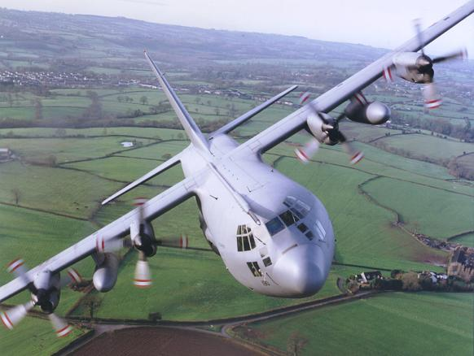
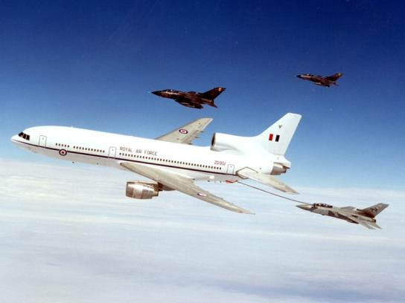
Thrust
How do we produce thrust?
1. Propellers
2. Jet engines
Notes:
Thrust
We have already seen that to generate lift, which is needed to oppose the weight of the aircraft and keep it in the air, the wings of an aircraft must have air flowing over them. This airflow is in turn produced by “thrusting” the aircraft forwards through the air - and of course it is the job of the aircraft’s engine (or engines) to provide the necessary force (called “thrust”).
The engine does this by throwing air backwards, either by having a propeller which “screws” the air backwards or by expelling air from the rear in the case of a jet engine. In both cases, throwing the air backwards thrusts the aircraft forward (Newton’s law about every action having an equal and opposite reaction). The thrust force acts approximately along a line drawn from the tail to the nose of the aircraft, and its size depends upon the amount of engine power selected by the pilot.

Slide 5
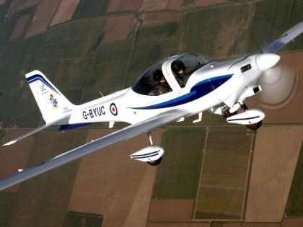
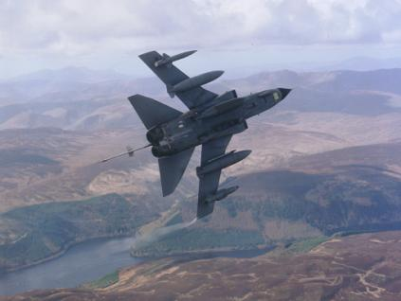
Remember Newton’s Third Law?
The engine achieves thrust by “pushing” the air backwards from either through a propeller or from the rear of a jet engine
The amount of thrust depends on engine size and altitude
Notes:
Discuss engine size, high low, altitude etc.
Remember - thrust is virtually a constant.

Slide 6
Drag
What is drag?
Remember riding a bicycle into a wind or riding faster?
PHEW!
Notes:
Drag
Anyone who has a bicycle will know that the faster you go, the more air resistance you encounter. The force which hinders your progress is called “drag”. The same thing happens when an aircraft is thrust through the air. The wings, fuselage, tail unit, undercarriage, engines, aerials - in fact every part of the aircraft over which the air flows - produces drag which resists forward motion. If all these drag forces are added together and are represented by a single line (as we did for the lift forces when discussing the centre of pressure), the line would run approximately from the nose to the tail of the aircraft, directly opposing the thrust.
Thus, the more drag there is, the more thrust is needed to overcome it. More thrust needs more engine power, which means a bigger engine, more fuel, more weight, more expense, more everything! It is the designer’s job to make the aircraft fly at the best possible speed for the thrust available. The more the designer can reduce the drag, the more efficient and economical the aircraft will be. So what causes drag and how can it be reduced to a minimum?

Slide 7
The amount of drag varies with the square of the airspeed
So:
Double the airspeed, then drag is four times as great!
Triple the airspeed, then drag is nine times as great!
Drag
Airspeed

Slide 8
Drag is the force which hinders your progress
The faster you go the more drag you feel
We need thrust to overcome the drag
Consider:
Airflow
The plate causes maximum drag
20 people are needed on the team
Notes:
A circular flat plate pulled into the along into the wind.
It takes, say, 20 people to pull it because of the drag.
White lines represent airflow

Slide 9
What happens when we pull a ball of the same diameter as the plate?
Airflow
Drag is now reduced by 50%
Now only 10 people are needed on the team
Notes:
A circular flat plate pulled into the along into the wind.
It takes, say, 20 people to pull it because of the drag.
White lines represent airflow

Slide 10
What happens we ‘streamline’ a shape of the same diameter?
Airflow
Drag is reduced to 5%
Now only one person needed
Notes:
A circular flat plate pulled into the along into the wind.
It takes, say, 20 people to pull it because of the drag.
White lines represent airflow.
Designing the streamline shapes to have a “fineness ratio” of between 3 and 4 to 1 (the fineness ratio being length compared to breadth, in order to reduce the size of the wake to a minimum.
The amount of drag varies with the square of the airspeed - that is, at twice the airspeed there is 4 times as much drag; at 3 times the airspeed, 9 times the drag; and so on.

Slide 11
Form Drag
Very turbulent wake
Reduction in Form Drag
50%
85%
90 - 95%

Slide 12
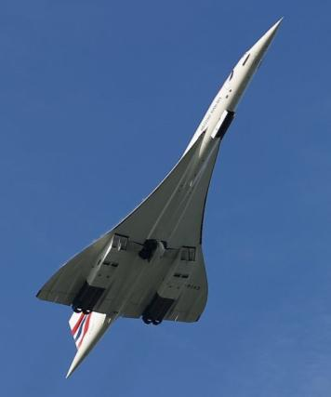
This type of drag is called Form Drag
It is determined by the shape of the object
So do we need:
OR
This shape?
This shape?
Reducing drag reduces the amount of thrust required
Notes:
Can use a model aircraft to show form drag.

Slide 13
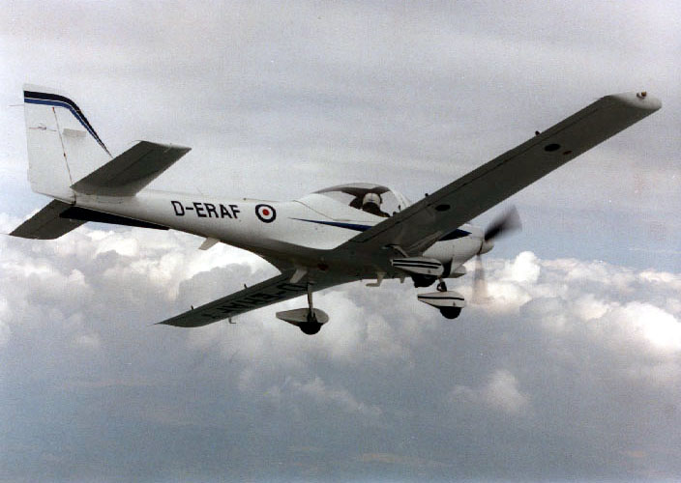
Streamlining
Notes:
Streamlining and “fairing off” all the parts of the aircraft which remain in the airflow, thus making the air flow as smoothly as possible, to reduce the size of the wake. The effective use of streamlining in reducing drag can be seen from the wind tunnel experiments shown in the diagram below. The drag on a flat plate can be reduced to 5% (1/20th) of the original by efficient streamlining.

Slide 14
Drag
Drag can be represented by the following graph:
TOTAL DRAG
DRAG
ZERO LIFT DRAG
LIFT DEPENDENT DRAG
IAS
V_{IMD}
Notes:
Discuss briefly the components, but emphasise the form drag part.
This is discussing variation of airspeed and drag.
Not important if they don’t get this.

Slide 15
Thrust and Drag in straight and level flight
1. Aircraft accelerating
What is the difference between thrust and drag?
Thrust is greater than drag

Slide 16
2. Aircraft decelerating
What is the difference between thrust and drag?
Drag is greater than thrust

Slide 17
3. Aircraft at constant speed
What is the difference between Thrust and Drag?
Thrust = Drag
Notes:
In steady (i.e. unaccelerated) straight and level flight, just as lift must equal weight so that the aircraft neither climbs nor descends, so the thrust must equal the total drag. If the thrust is greater than the total drag, the aircraft will gather speed. If the total drag exceeds the thrust, the aircraft will slow down.
In steady straight and level flight, the thrust equals the total drag. This point is not always easy to understand and at first it may be thought that if the thrust equals the total drag an aircraft must be stationary! But if an aircraft were stationary there would be no drag! A comparison may help you understand. If you pedal a cycle on a level road at a constant 15 kph, the propelling force you produce is a steady thrust exactly equalling the drag of machine and rider through the air plus the friction on bearings and tyres. If you increase your pedalling effort (or thrust), at first you will gather speed. As your speed increases, the drag of the wind and friction will
also increase, until it equals your new pedalling force. You will then stay at a new constant speed, say 20 kph, with steady thrust equalling steady drag. If your pedalling force is reduced (less thrust) or a head wind arises (more drag) the cycle will slow down until it is at a new constant speed where the drag and thrust are once again equal.
The Aircraft in Balance
In straight and level flight at constant speed, two pairs of forces act on the aircraft. The thrust opposes the drag and is equal to it and the lift equally opposes the weight.

Slide 18
For straight and level flight
at constant speed
ALL forces are in balance
Lift
Drag
Thrust
Weight
Notes:
What forces are present in S&L Flt?
Where do these forces act through? Show Centre of Gravity CG.
Could show CG using an odd shaped object

Slide 19
Any questions?

Slide 20
Questions for you …….

Slide 21
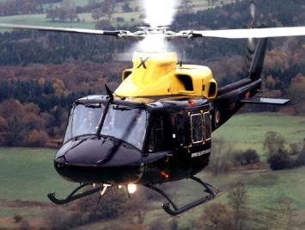
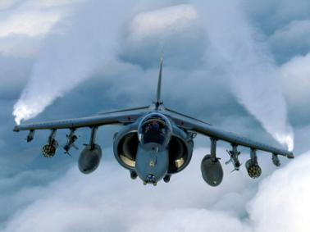
1. What is the force called that drives an aircraft forwards?
Lift
Weight
Drag
Thrust

Slide 22
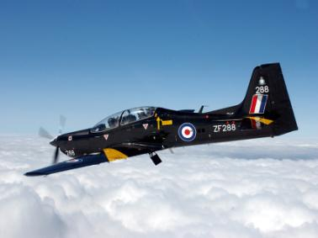
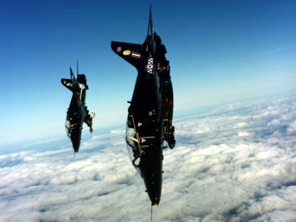
2. What is the force called that resists the forward motion of an aircraft?
Lift
Weight
Drag
Thrust

Slide 23
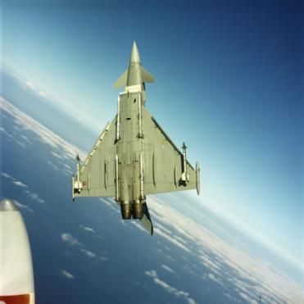
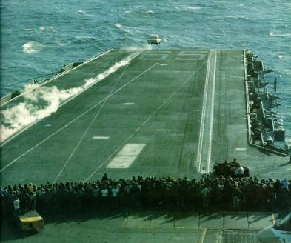
3. If you speed is doubled, by how much would the drag be increased?
x2
x4
x6
x8

Slide 24
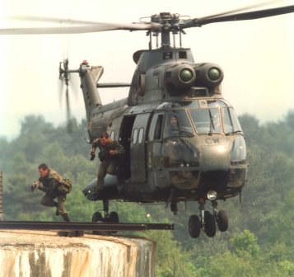
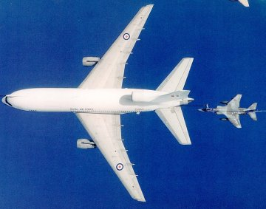
4. If Thrust = Drag and Lift = Weight
then the aircraft is:
Climbing
Flying straight and level and accelerating
Flying straight and level and decelerating
Flying straight and level at a constant speed

